Slide 1
Chemistry Research Laboratory
NMR Spectroscopy Facility
Introductory Lecture
Dr. Nick Rees
nick.rees@chem.ox.ac.uk
nmrweb.chem.ox.ac.uk

Slide 2
Introductory Lecture
NMR Facility Staff
Magnet Hazards and Safety
Sample Preparation
Data Processing
Facilities and Instrumentation
Open Access Facilities
NMR Submission Service
On-line Resources: NMR web site
Future training courses

Slide 3
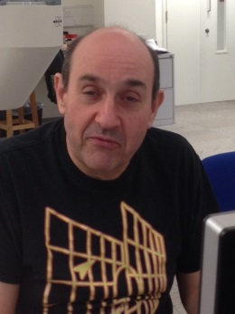
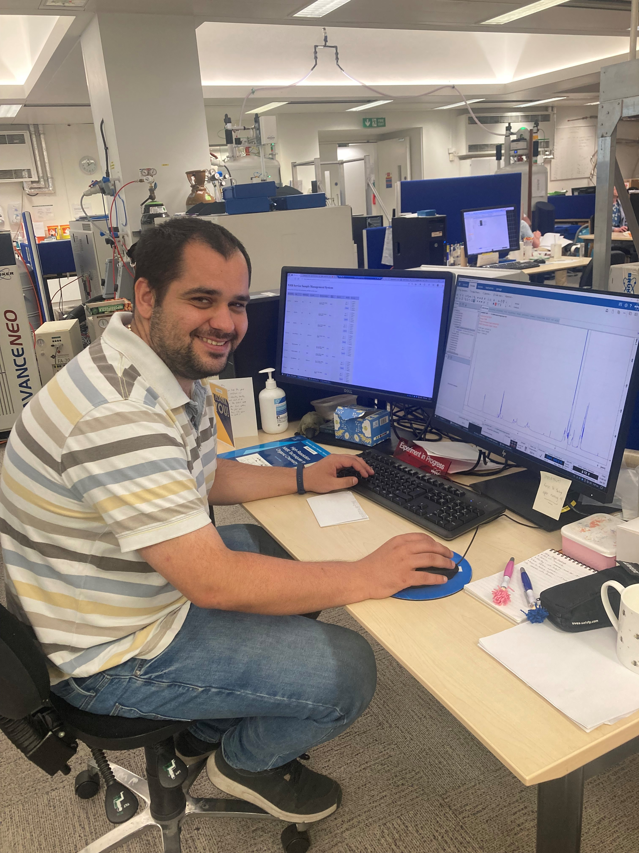
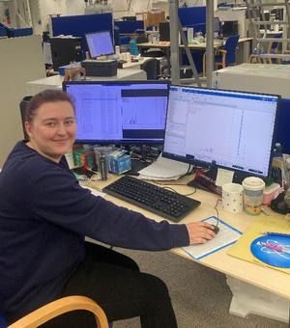
1. NMR Staff
Facility Director:
Dr Nick Rees
Service Manager:
Dr James Montgomery
Service Technician:
Caitlin Salter
NMR Officer:
Coral Mycroft
Nick
Caitlin
nmrstaff@maillist.chem.ox.ac.uk
James
Coral

Slide 4
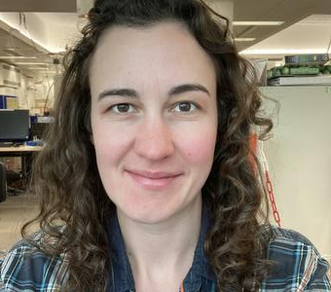
1. NMR Staff
Facility Director:
Dr Nick Rees
Service Manager:
Dr Coral Mycroft
Service Technician:
Caitlin Salter
NMR Officer:
Charlie Prentice
Nick
Caitlin
nmrstaff@maillist.chem.ox.ac.uk
Coral
Charlie

Slide 5
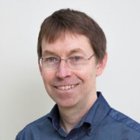
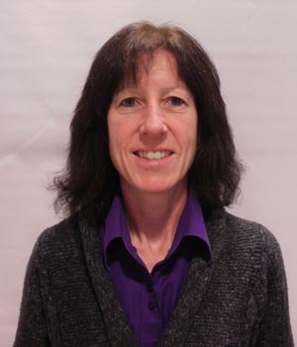
Former NMR Staff
Prof Tim Claridge
Maria Marshall

Slide 6
2. Safety in the NMR laboratories
Very Strong Magnetic Fields!
Hazards to:
heart pacemakers
magnetic bank or ID cards
watches (non-LCD)
Stray fields in corridors!
especially ground floor NMR

Slide 7
Safety Rules
No laboratory coats in NMR labs.
No metal objects to be taken into NMR labs.
Sample breakages must be dealt with immediately
Inform the NMR staff if in any doubt

Slide 8
Accessibility in the NMR laboratories
If you require any assistance or adjustments in relation to training and/or using this facility or if you have any concerns you would like to discuss beforehand, contact
nick.rees@chem.ox.ac.uk

Slide 9
3. Sample Preparation
Tubes and deuterated solvents from stores
Tubes must be “Wilmad 507” or “Norell S400” grade (or equivalent) at least
Tubes must not be scratched or broken
Label tubes very carefully (Group & User Initials minimum)
Solutions must be correct depth (4 cm)
Solutions must be free from particulates

Slide 11
3. Sample Preparation
Tubes and deuterated solvents from stores
Tubes must be “Wilmad 507” or “Norell S400” grade (or equivalent) at least
Tubes must not be scratched or broken
Label tubes very carefully
Solutions must be correct depth (4 cm)
Solutions must be free from particulates
Dry tubes carefully; acetone rinse then:
Leave on vacuum line for some hours
Lay flat in oven, 1 hour @ 100 ºC max

Slide 12
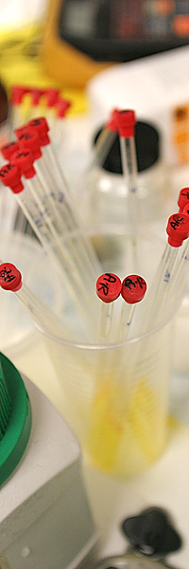
NMR Tube Cap Colours for Organic Chemistry and Chemical Biology groups
Group | Floor | Colour
Professor E. A. Anderson | 1 | WHITE
Professor J. Burton | 1 | YELLOW
Professor T. J. Donohoe | 1 | PURPLE
Professor V. Gouverneur | 1 | PINK + BLACK
Professor D. M. Hodgson | 1 | FUCHSIA + BLACK
Professor M. G. Moloney | 1 | GREEN + BLACK
Professor M. D. Smith | 1 | BLUE + BLACK
Professor M. C. Willis | 1 | AQUA + BLACK
Professor H. L. Anderson | g | SKY
Professor S. J. Conway | g | AQUA
Professor S. G. Davies | g | RED
Professor D. J. Dixon | g | BLACK
Professor S. P. Fletcher | g | SKY + BLACK
Professor I. McCulloch | g | RED
Professor J. Robertson | g | ORANGE + BLACK
Professor A. J. Russell | g | FUCHSIA
Professor H. Bayley | lg | PINK
Dr. M. J. Booth | lg | WHITE + BLACK
Professor B. G. Davis | lg | GREEN
Professor C. J. Schofield | lg | ORANGE
Professor T. Brown |  | BLUE
AQUA, BLACK, BLUE, FUCHSIA, GREEN, ORANGE, PINK, PURPLE, RED, SKY, WHITE, YELLOW

Slide 13
Sample masses required
Rule of thumb for high-quality spectra (minimum):
400 MHz Open-access spectrometers:
Proton & 2D COSY: 2 mgs
2D H-C HSQC: 10 mgs
1D Carbon: 20 mgs
Please weigh your samples!!

Slide 14
How much is 10 mg? NMR tube cap Glycine Camphor CuSO₄

Slide 15
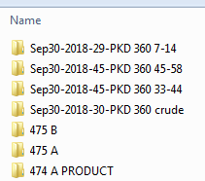
4. Data Processing & Storage
Data from all spectrometers can be downloaded ONLY from the on-line archive for off-line processing and local storage
NMR Store & archive:
Chemistry domain file sharing:
\\chem.ox.ac.uk\SRF\NMR
Macs:
smb://chem.ox.ac.uk/SRF/NMR

Slide 16
Data Processing Software
Windows and Macs:
MestreNova: 1D and 2D processing; platform independent
Chemistry site licence
Windows and Macs:
TOPSPIN: Used on all spectrometers, 1D/2D NMR processing;
Free for academic use

Slide 17
Software installation
Departmental PCs and Laptops:
MestreNova: Download latest version from Mestrelabs website. Copy and install licence from NMR server (\\chem.ox.ac.uk\SRF\NMR\NMR Software\Mnova\)
www.mestrelab.com
Topspin: Download from Bruker site and request licence:
https://www.bruker.com/service/support-upgrades/software-downloads/nmr.html

Slide 18
5. How to use the facilities
Facilities operate at 4 levels:
“open-access”: automated instruments for all to use
“hands-on”: manual use of instruments for specifically trained users
“submission service”: analytical service provided by the NMR staff
“research projects”: collaborative projects involving the NMR staff/group

Slide 19
NMR in CRL [Instrument nicknames shown]
Organic/Chem Biol
Section
Inorganic
Section
DPX200, AVF400
AVG400, AVH400
None
AVB400, AVB500, AVX500,
NEO600, AV600, AV700
Venus400 +Mercury400
AVD500, Solids [HFX400 and HXY400]
Second
First
Ground
Lower ground
Basement

Slide 20
Organic Chemistry and Chemical Biology Instrumentation
10 research instruments @ 200-700 MHz
1 @ 200 MHz: Open Access ¹H and ¹³C
3 @ 400 MHz: Open Access ¹H, ¹³C, ¹⁹F, ³¹P & 2D
1 @ 400 MHz: Hands on multinuclear and VT work
2 @ 500 MHz: Hands on use & Service work
1 @ 600 MHz: Service work (NEO)
1 @ 600 MHz: Research projects
1 @ 700 MHz: Research projects

Slide 21
Open access 200/400 MHz facilities
Automated 200 and three 400s
Provide rapid access to basic 1D & 2D ¹H and ¹³C spectra, plus ¹⁹F and ³¹P
Available to all research workers
Spectra provided as PDF files and data on server
Training must be given by a member of the Analytical staff:
Sessions will run Tuesday 3rd (pm), Thurs 5th (pm) and Fri 6th (am): Meet in CRL reception
On-line booking and registration is required

Slide 22
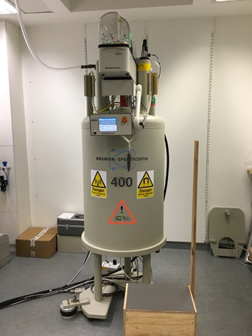
Automated AVIII400 [Ground Floor]
Known as the AVG400
¹H, ¹³C, ¹⁹F, ³¹P
2D COSY
2D HSQC
file://chem.ox.ac.uk/SRF/NMR/AVG400/setup.html

Slide 23
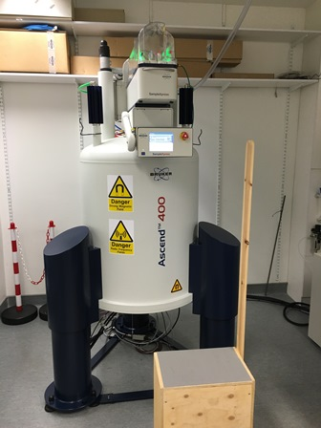
Automated AVIII400 [Ground Floor]
Known as the AVH400
¹H, ¹³C, ¹⁹F & ³¹P
2D COSY
2D HSQC
Faster for ¹H than AVF400 or AVG400
file://chem.ox.ac.uk/SRF/NMR/AVH400/setup.html

Slide 24
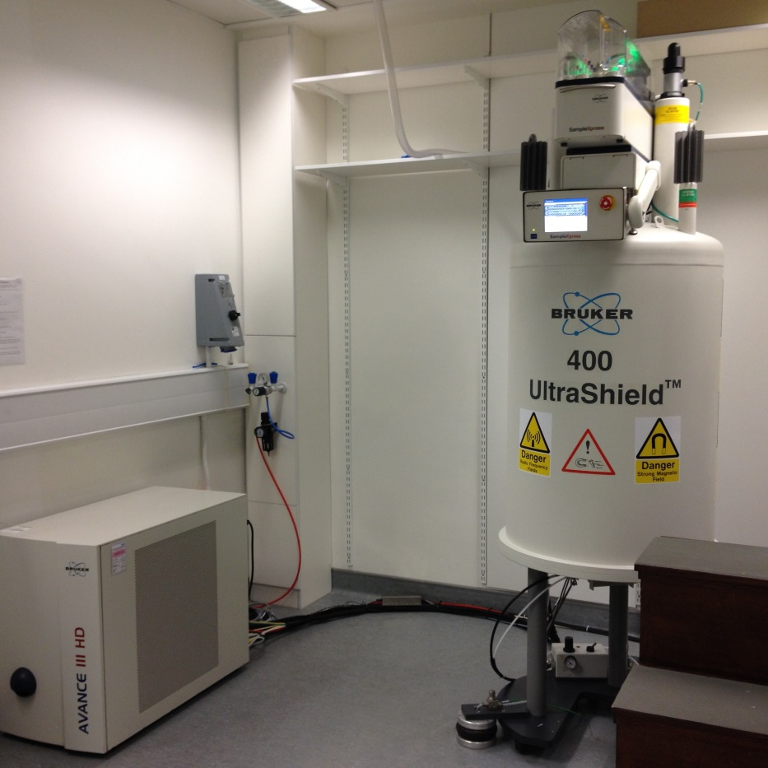
Automated AVIII 400 [1st Floor]
Known as the AVF400
¹H, ¹³C, ¹⁹F & ³¹P
2D COSY
2D HSQC
Generally very busy- only submit experiments you are sure are essential!
Check ¹H only first
file://chem.ox.ac.uk/SRF/NMR/AVF400/setup.html

Slide 25
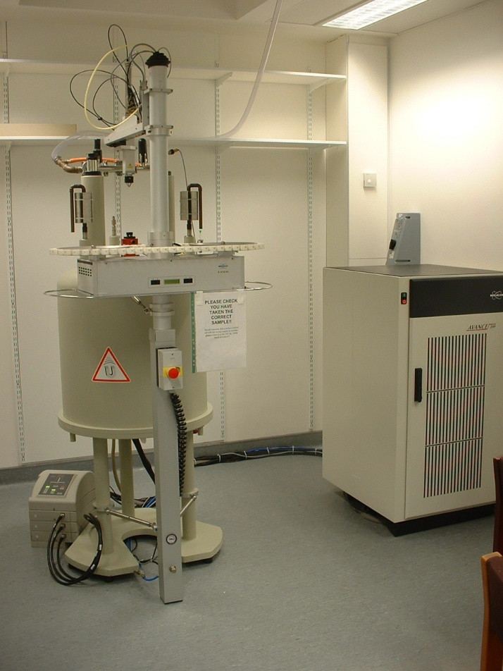
Semi-Automated DPX200 [1st Floor]
¹H NMR
Meant for fast ¹H screening- first come, first served.
No robot operation.
file://chem.ox.ac.uk/SRF/NMR/DPX200/setup.html

Slide 26
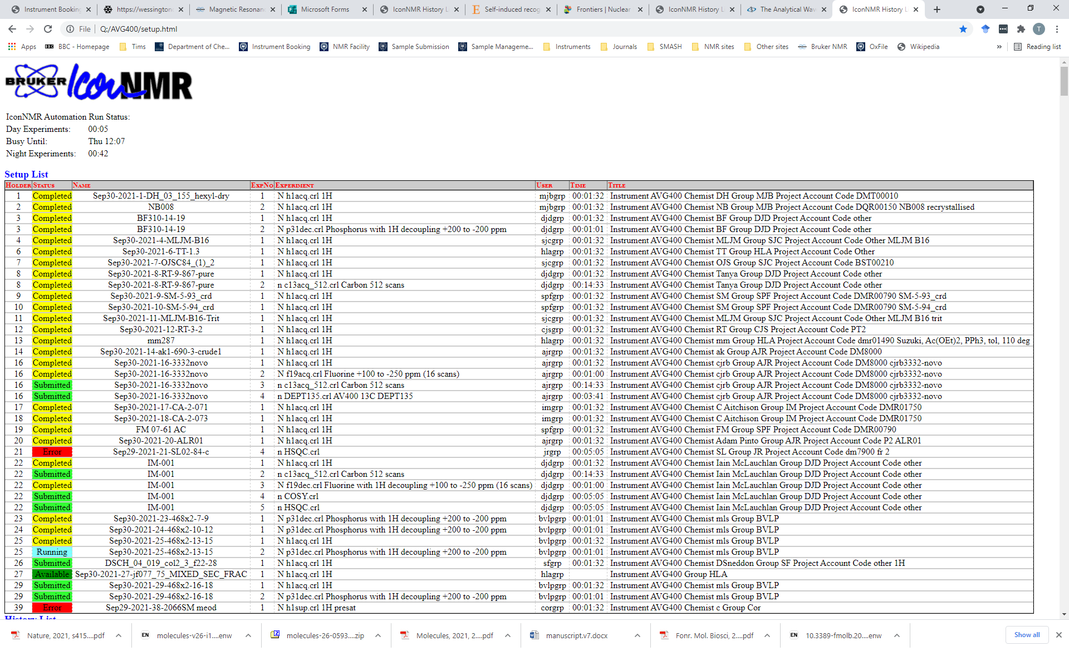
Instrument status web pages

Slide 27
High-field facilities
Basement high-field NMR lab
400 and 500 MHz instruments available for specifically trained users (“hands-on” use). 600/700 MHz for bio-projects
Training must be given by NMR staff
Please enquire with NMR Staff if you wish to be trained
On-line booking (intranet)- registration is required:
https://intranet.chem.ox.ac.uk/booking/default.html

Slide 28
NMR Submission Service
Many routine 1D and 2D ¹H, ¹³C, ¹⁹F, ³¹P, & ¹¹B experiments can be performed using open-access 400 MHz
Daily service provided by Dr Coral Mycroft and Caitlin Salter
NMR Service uses 500 & 600 MHz instruments not 400
Each sample must have electronic submission form (Word) and ¹H spectrum (PDF) of same sample

Slide 29
NMR on-line Submission
http://www.chem.ox.ac.uk/samples
Sample Number is unique for every NMR sample tube submitted and is used to track samples- every tube ID tag must be labelled with this number (at least)

Slide 30
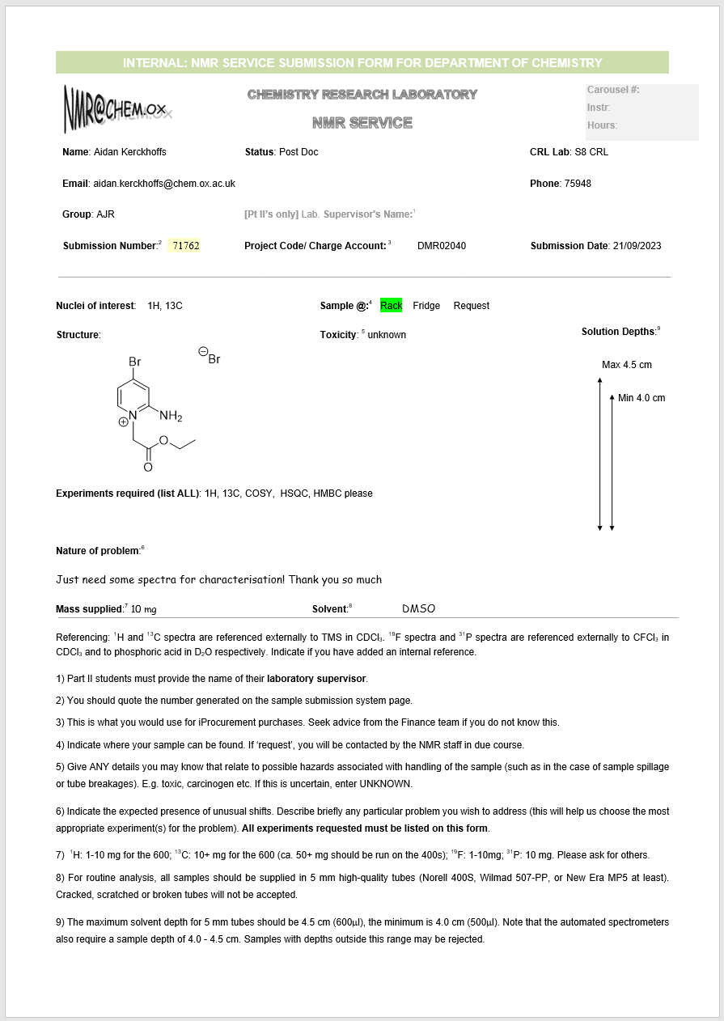
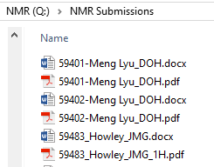
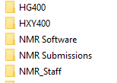
Sample Submission Form: Word document
Part IIs should enter: p2
FORM
SPECTRUM
The sample submission process will also be explained to you as part of your open-access training…

Slide 31
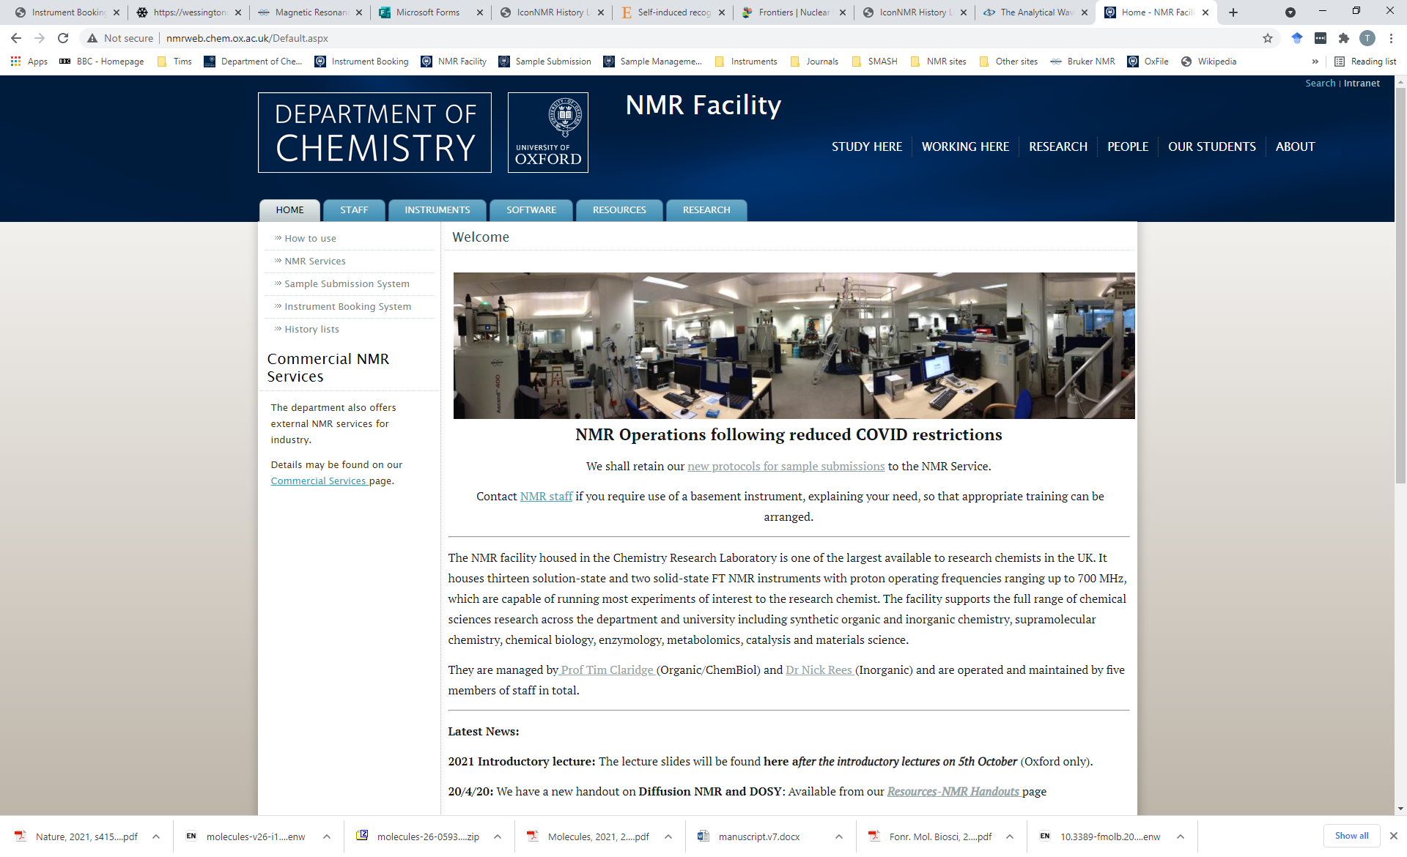
On-line resources
NMR web pages:
http://nmrweb.chem.ox.ac.uk/
or through Intranet Link to Analytical Facilities on Chemistry homepage.

Slide 32
Future training courses
Use of the Open-Access NMR Spectrometers & Service
Running this week- meet in CRL reception
Compulsory sessions- you must attend before using instruments or the NMR submission service.
Mnova NMR Software Introductory Lecture
Single on-line lecture introducing main software features
Modern NMR Spectroscopy for the Research Chemist
8-lecture course providing overview of NMR techniques
This course can be found on the Oxford Canvas site at: https://canvas.ox.ac.uk/courses/54457
CDT students
NMR training courses in Jan 2024: DO NOT SIGN UP FOR TRAINING THIS WEEK

Slide 33
Inorganic Chemistry Instrumentation
5 research instruments @ 400-500 MHz
1 @ 400 MHz: Open Access multinuclear
1 @ 400 MHz: Open Access multinuclear
1 @ 500 MHz: Hands on & Service multinuclear and VT work
1 @ 400 MHz: Service Solid State HXY
1 @ 400 MHz: Service Solid State HFX, microimaging
& diffusion
Access to 600 MHz: Service ¹H and ¹³C

Slide 34
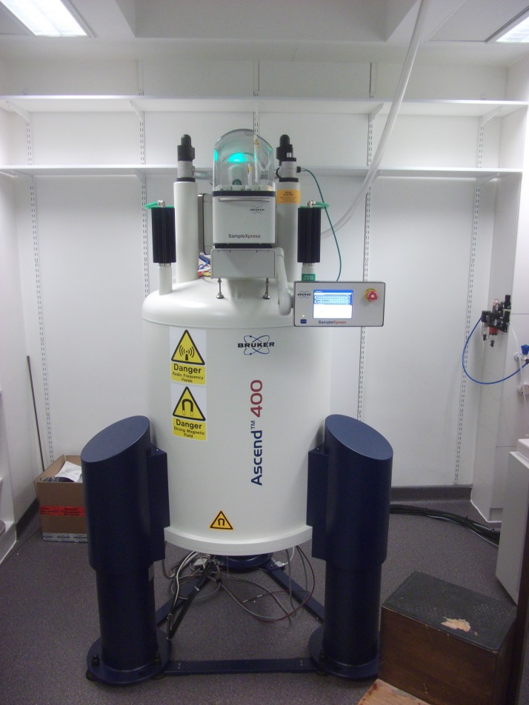
Automated AVIIIHD400 [2nd Floor]
Known as the Hg400
60 place autosampler
¹H, ¹⁹F, ³¹P to ¹³C
¹H–¹H, ¹H-¹³C gradient selected 2-D experiments
Meant for fast daytime turnaround & longer overnight experiments
file://chem.ox.ac.uk/SRF/NMR/HG400/setup.html

Slide 35
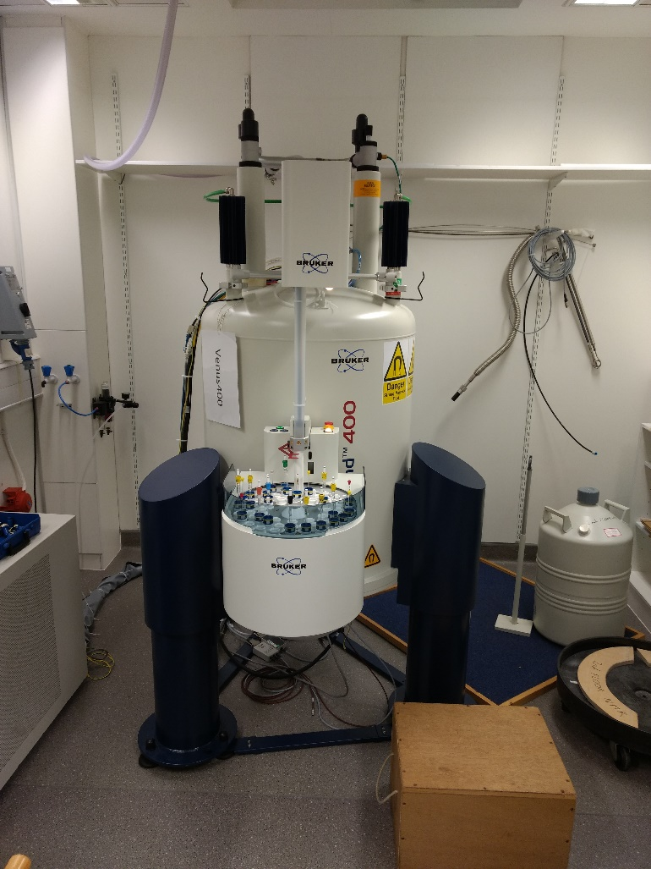
Automated AVIII400 [2nd Floor]
Known as Venus400
60 place autosampler
¹H, ¹⁹F, ³¹P to ¹³C
¹H–¹H, ¹H-¹³C gradient selected 2-D experiments
Meant for fast daytime turnaround & longer overnight experiments
file://chem.ox.ac.uk/SRF/NMR/VENUS400/setup.html

Slide 36
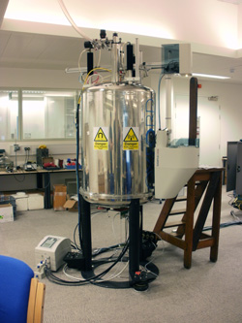
Hands on AVIII500 [basement]
Known as the AVD500
24 place autosampler
¹H, ¹⁹F to ¹⁰⁹Ag
¹H–¹H, ¹H-X gradient selected 2-D experiments
VT work
Booking required (on-line system)

Slide 37
Solid state NMR
Service provided by Dr Nick Rees
Stable samples provided as a solid (c.a. 200mg)
Unstable samples can be packed in glove box
Consult Nick Rees before submitting samples
nick.rees@chem.ox.ac.uk
Submit Samples via the Sample submission service
Stable samples should be placed in the box through the basement NMR lab hatch
For unstable samples provide email address on submission form.

Slide 38
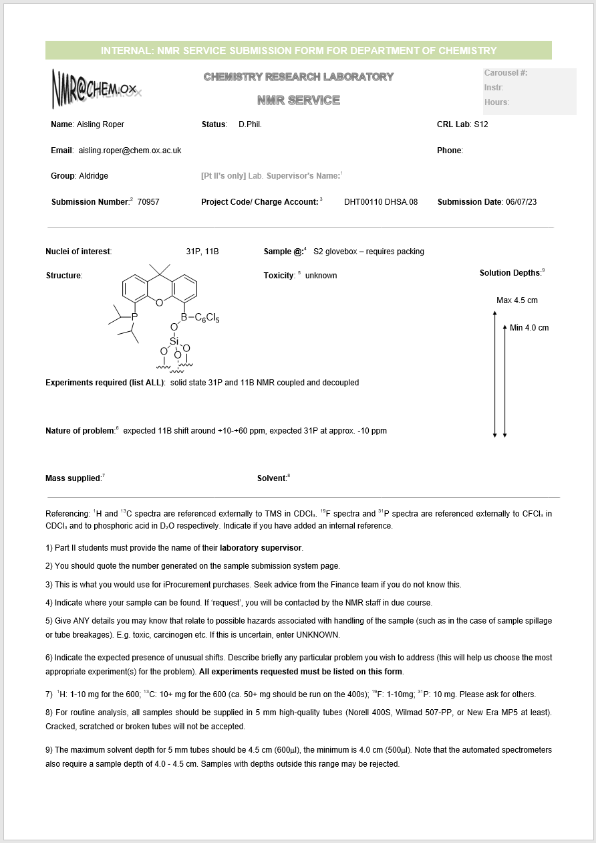
Sample Submission Form: Word document
Solid state NMR
List experiments
And specify SSNMR
If needs to be packed in glove box give contact email address
The sample submission process will also be explained to you as part of your open-access training…

Slide 39
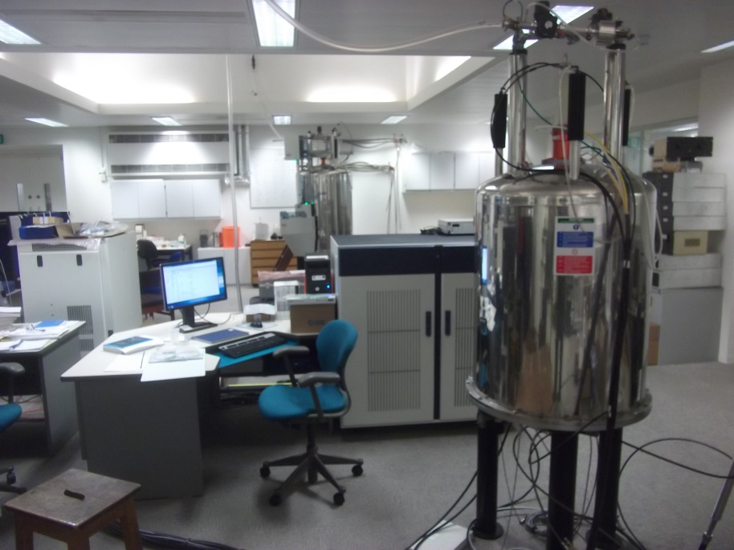
Solid State AVIIIHD400WB [basement]
Known as the HXY400
4 & 1.9 mm Triple Magic Angle Spinning Probes (¹H, ¹⁹F, ³¹P to¹⁵N)
4mm Low Gamma (¹³C to ¹⁰⁹Ag) Magic Angle Spinning Probe
Wideline Deuterium Probe
Goniometer probe for oriented samples
Variable temperature capable (-150 to 150C)

Slide 40
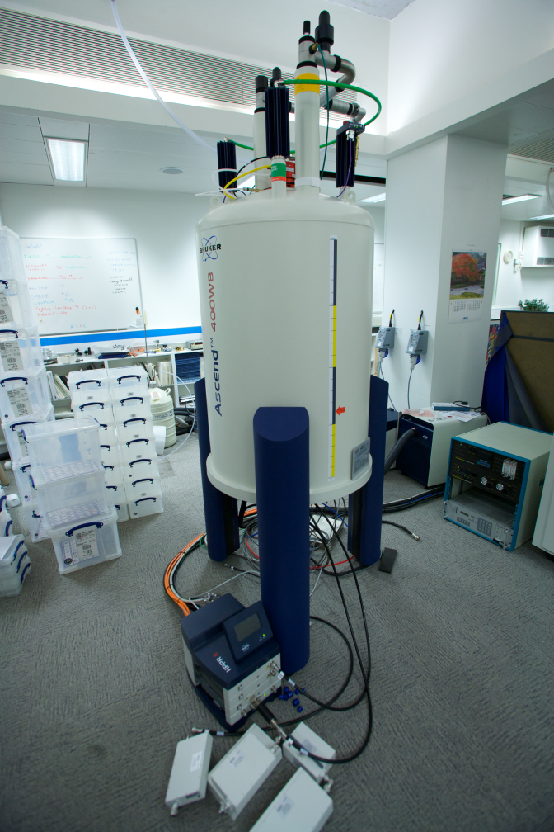
Solid State AVIIIHD400WB [basement]
Known as the HFX400
3.2mm HFX Triple Magic Angle Spinning Probes (¹H, ¹⁹F, ³¹P to¹⁵N)
30mm Micro-imaging probe
Diffusion probe
Variable temperature capable (-150 to 150C)

Slide 41
Inorganic Open-Access training:
Use of the Open-Access NMR Spectrometers & Service
Running this week- meet in CRL reception
Compulsory sessions- you must attend before using instruments or the NMR submission service.
Mnova NMR Software Introductory Lecture
Single on-line lecture introducing main software features
CDT students
NMR training courses in Jan 2024: DO NOT SIGN UP FOR TRAINING THIS WEEK

Slide 42
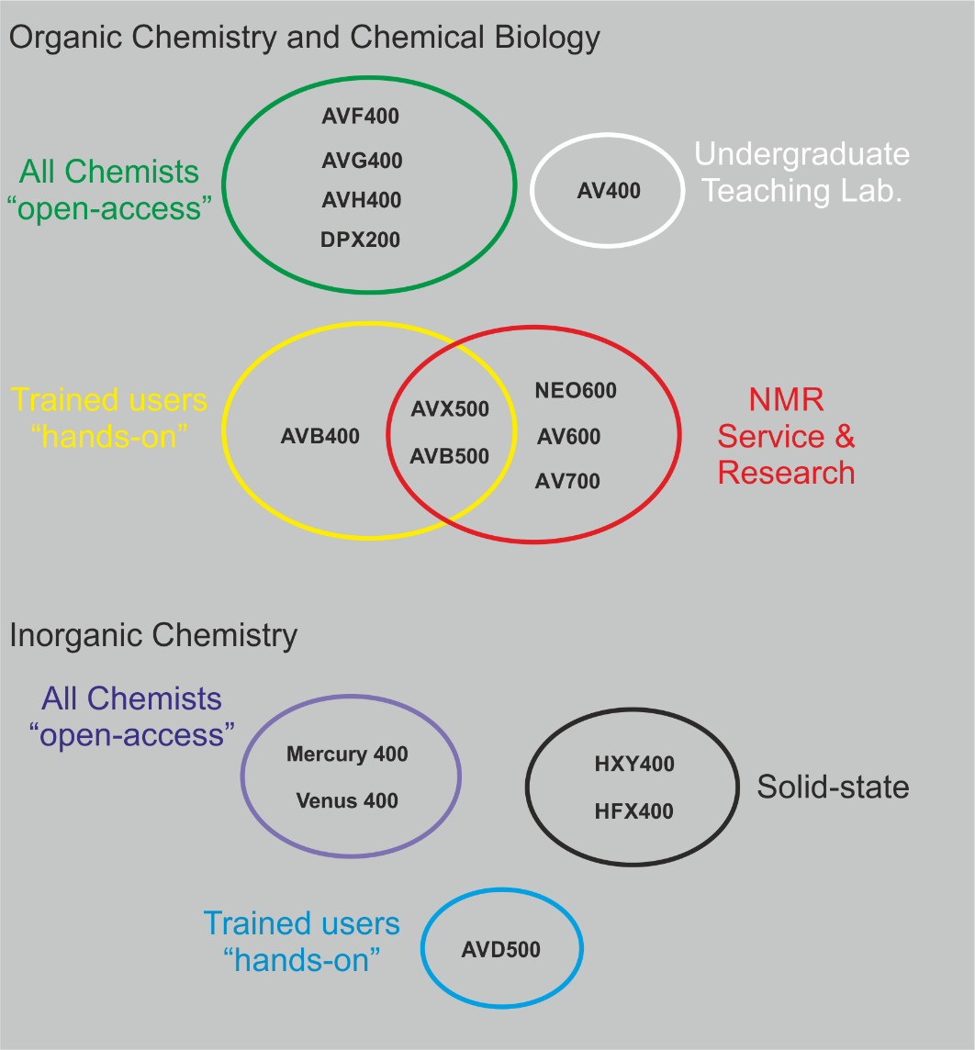
Instrumentation Access

Slide 43
NMR training for new researchers
1: Register as an Organic Section NMR user:
https://forms.office.com/e/sYyFxBKJ7e or
1: Register as an Inorganic Section NMR user:
https://forms.office.com/r/h30g6LxEsT
2: Sign up for a training session
Select Organic Section NMR: or Inorganic Section NMR:
https://outlook.office365.com/owa/calendar/SRFInductions2023@UniOxfordNexus.onmicrosoft.com/bookings/
Meet for training in CRL reception
To arrange training external users should email: nmrstaff@maillist.chem.ox.ac.uk
All the above links can be found in these slides on-line at:
http://nmrweb.chem.ox.ac.uk/

Slide 44
QR for training sign-up sheets

